Slide 1
Walmart Sales Analysis
MySQL portfolio project
Intermediate level Data Analysis
Dharmindar Ram Linkedin Portfolio Github E-mail

Slide 2
Key Skills practised:
Walmart Sales Analysis
MySQL(Switch CASE, ALTER table, UPDATE table, DISTINCT, GROUP BY, HAVING clause, ORDER BY, DESC, SUM, AVG, COUNT, WHERE clause, ALIASING)
Feature Engineering(Created 3 new columns based on existing ones)
Data Analysis
Business Insights
Dharmindar Ram Linkedin Portfolio Github E-mail

Slide 3
Project Purpose:
Walmart Sales Analysis
The major aim of this project is to gain insights and to improve its sales. Into the sales data of three cities i.e. Yangon, Naypyitaw and Mandalay, Walmart to understand how sales strategies can be improved and optimized by understanding the different factors that affect sales of the different branches.
Dharmindar Ram Linkedin Portfolio Github E-mail

Slide 4
About Project:
Walmart Sales Analysis
This project aims to explore the Walmart Sales data to understand top performing branches and products, sales trend of different products and customer behaviour.
Dharmindar Ram Linkedin Portfolio Github E-mail

Slide 5
About Data:
Walmart Sales Analysis
The dataset was obtained from the [Kaggle Walmart Sales Forecasting Competition]
The data contains 17 columns and 1000 rows.
After filtering the NULL values, dataset have only 995 records left for analysis.
Dharmindar Ram Linkedin Portfolio Github E-mail

Slide 6
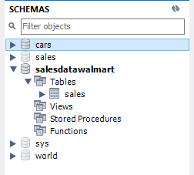
Approach Used:
Walmart Sales Analysis
1. Data Wrangling:-
Created a database named 'SalesDataWalmart', then created a table 'sales' with 17 columns and inserted data into this tables from a csv file. While creating table I set columns as ''NOT NULL' so null or missing values are filtered out.
Dharmindar Ram Linkedin Portfolio Github E-mail

Slide 7
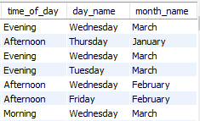
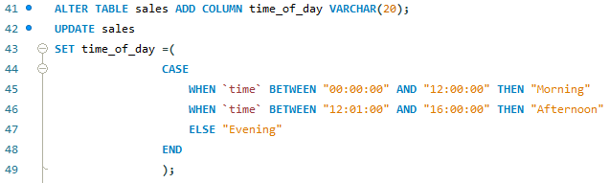
Approach Used:
Walmart Sales Analysis
2. Feature Engineering:-
This helped generate some new columns (`time_of_day`, `day_name` and `month_name`) from existing ones.
Dharmindar Ram Linkedin Portfolio Github E-mail

Slide 8
Approach Used:
Walmart Sales Analysis
3. Exploratory Data Analysis(EDA):-
Performed Exploratory data analysis to answer the listed questions and aims of this project.
Dharmindar Ram Linkedin Portfolio Github E-mail

Slide 9
Analysis List:
Walmart Sales Analysis
Product Analysis
Sales Analysis
Customer Analysis
Dharmindar Ram Linkedin Portfolio Github E-mail

Slide 10
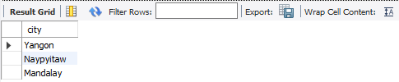
Generic Question
Walmart Sales Analysis
How many unique cities does the data have?
Dharmindar Ram Linkedin Portfolio Github E-mail

Slide 11

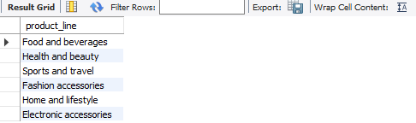
Product Questions
Walmart Sales Analysis
1. How many unique product lines does the data have?
Dharmindar Ram Linkedin Portfolio Github E-mail

Slide 12
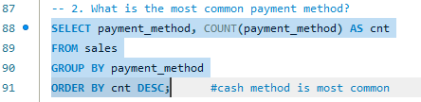

Product Questions
Walmart Sales Analysis
2. What is the most common payment method?
Dharmindar Ram Linkedin Portfolio Github E-mail

Slide 13
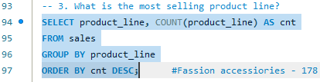
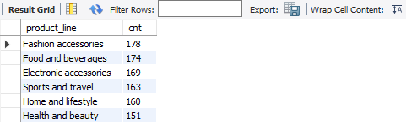
Product Questions
Walmart Sales Analysis
3. What is the most selling product line?
Dharmindar Ram Linkedin Portfolio Github E-mail

Slide 14
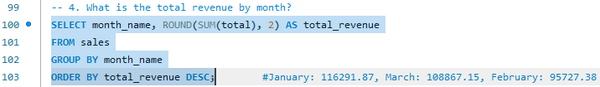

Product Questions
Walmart Sales Analysis
4. What is the total revenue by month?
Dharmindar Ram Linkedin Portfolio Github E-mail

Slide 15
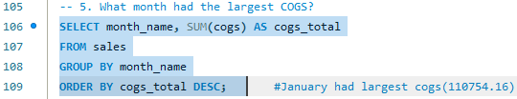

Product Questions
Walmart Sales Analysis
5. What month had the largest COGS?
Dharmindar Ram Linkedin Portfolio Github E-mail

Slide 16
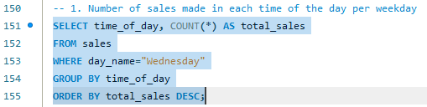

Sales Questions
Walmart Sales Analysis
1. Number of sales made in each time of the day per weekday
Dharmindar Ram Linkedin Portfolio Github E-mail

Slide 17
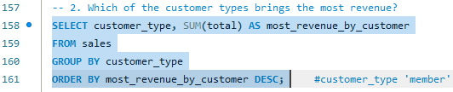

Sales Questions
Walmart Sales Analysis
2. Which of the customer types brings the most revenue?
Dharmindar Ram Linkedin Portfolio Github E-mail

Slide 18


Sales Questions
Walmart Sales Analysis
3. Which city has the largest tax percent/ VAT (**Value Added Tax**)?
Dharmindar Ram Linkedin Portfolio Github E-mail

Slide 19
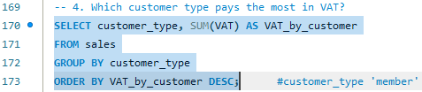

Sales Questions
Walmart Sales Analysis
4. Which customer type pays the most in VAT?
Dharmindar Ram Linkedin Portfolio Github E-mail

Slide 20


Customer Questions
Walmart Sales Analysis
1. How many unique customer types does the data have?
Dharmindar Ram Linkedin Portfolio Github E-mail

Slide 21

Customer Questions
Walmart Sales Analysis
2. How many unique payment methods does the data have?
Dharmindar Ram Linkedin Portfolio Github E-mail

Slide 22
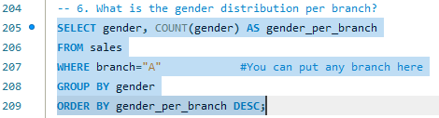

Customer Questions
Walmart Sales Analysis
3. What is the gender distribution per branch?
Dharmindar Ram Linkedin Portfolio Github E-mail

Slide 23
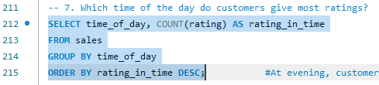

Customer Questions
Walmart Sales Analysis
4. Which time of the day do customers give most ratings?
Dharmindar Ram Linkedin Portfolio Github E-mail

Slide 24
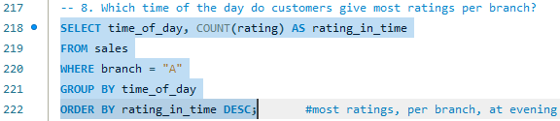

Customer Questions
Walmart Sales Analysis
5. Which time of the day do customers give most ratings per branch?
Dharmindar Ram Linkedin Portfolio Github E-mail

Slide 25
Project Insights:
Walmart Sales Analysis
Food and beverages had the largest revenue compared to other product lines
Branch A sell more products compared to other 2 branches i.e. B and C
The city Naypyitaw was leading by revenue compared to other 2 cities
In most of the days, sales occurred at evening with most ratings
Fashion accessories is the top selling product line by women
Registered members brought the most revenue
Dharmindar Ram Linkedin Portfolio Github E-mail

Slide 26
Project Findings:
Walmart Sales Analysis
Target the registered members living in the city Naypyitaw near branch A by showing them ads/offers/coupons mostly in the evening. Also give deals on 'Fashion accessories' as it is top selling product line by women.
Dharmindar Ram Linkedin Portfolio Github E-mail

Slide 27

DHARMINDAR RAM
Data Enthusiast | ML Engineer | Data Analyst
Linkedin Portfolio Github E-mail

